Slide 1

UECS3213 / UECS3453 Data Mining Topic 3c: Evaluating Classifier
Dr. Simon Lau Boung Yew

Slide 2
Outline
Practical Issues of Classification
Underfitting and Overfitting
Performance Evaluation
Method for Performance Evaluation:
Confusion Matrix
Model Evaluation
Holdout Method
Random Subsampling
K-fold Cross Validation
Leave-one-out Cross validation
Receiver Operating Characteristic (ROC) Curve

Slide 3
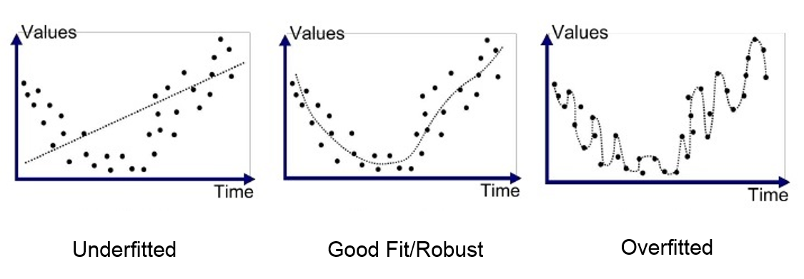
Practical Issues of Classification
Underfitting and Overfitting
Performance Evaluation

Slide 4
What is a model?
A model is a system for mapping inputs to outputs.
For example, if we want to predict house prices, we could make a model that takes in the square footage of a house and outputs a price.
A model represents a theory about a problem
Models are useful because we can use them to predict the values of outputs for new data points given the inputs.
A classification model (classifier) is a mapping of instances between certain classes/groups.
The classifier or diagnosis result can be
a real value (continuous output), in which case the classifier boundary between classes must be determined by a threshold value (for instance, to determine whether a person has hypertension based on a blood pressure measure), or
a discrete class label, indicating one of the classes.
Notes:
https://towardsdatascience.com/overfitting-vs-underfitting-a-complete-example-d05dd7e19765
https://chemicalstatistician.wordpress.com/2014/03/19/machine-learning-lesson-of-the-day-overfitting-and-underfitting/
https://docs.aws.amazon.com/machine-learning/latest/dg/model-fit-underfitting-vs-overfitting.html

Slide 5
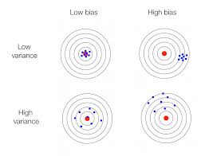
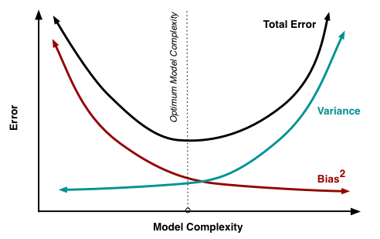
Bias vs Variance
The bias is an error from erroneous assumptions in the learning algorithm. High bias can cause an algorithm to miss the relevant relations between features and target outputs (underfitting).
The variance is an error from sensitivity to small fluctuations in the training set. High variance can cause an algorithm to model the random noise in the training data, rather than the intended outputs (overfitting).
Notes:
https://en.wikipedia.org/wiki/Bias%E2%80%93variance_tradeoff
https://insidebigdata.com/2014/10/22/ask-data-scientist-bias-vs-variance-tradeoff/

Slide 6
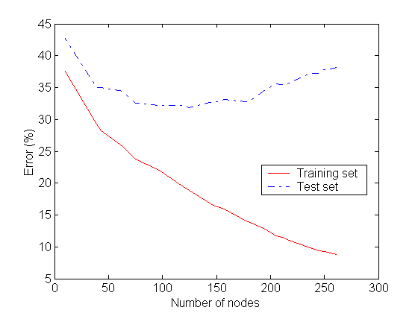
Underfitting and Overfitting
Underfitting: when model is too simple, both training and test errors are large
Underfitting
Overfitting
Overfitting: when model is too complex it models the details of the training set and fails on the test set

Slide 7
Underfitting
Both overfitting and underfitting lead to poor predictions on new data sets.
Underfitting occurs when a statistical model or machine learning algorithm performs poorly on the training data.
This is because the model is unable to capture the relationship between the input examples (often called X) and the target values (often called Y).
Model does not fit the data well enough.
low variance but high bias

Slide 8
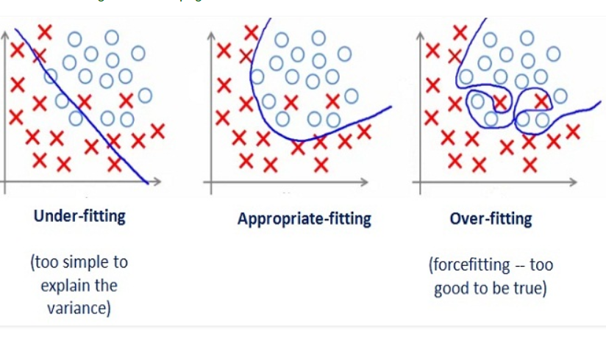
Overfitting
Overfitting results in decision trees that are more complex than necessary
Captures the noise of the data, fits the data too well
Model is overfitting training data when the model performs well on the training data but does not perform well on the test data.
This is because the model is memorizing the data it has seen and is unable to generalize to unseen examples.
Training error no longer provides a good estimate of how well the tree will perform on previously unseen records
The model does not generalize well
Low training error but high test error
low bias but high variance

Slide 9
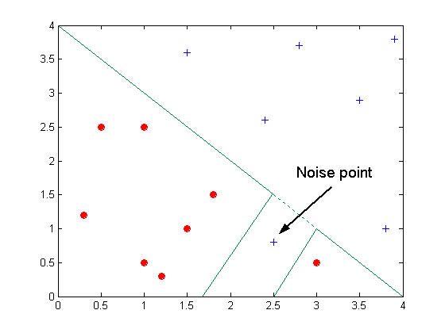
Overfitting due to Noise
Decision boundary is distorted by noise point

Slide 10
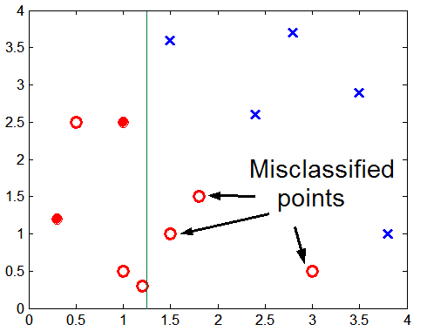
Overfitting due to Insufficient Examples
Lack of data points in the lower half of the diagram makes it difficult to predict correctly the class labels of that region
Insufficient number of training records in the region causes the decision tree to predict the test examples using other training records that are irrelevant to the classification task

Slide 11
Model Evaluation
Metrics for Performance Evaluation
How to evaluate the performance of a model?
Methods for Performance Evaluation
How to obtain reliable estimates?
Methods for Model Comparison
How to compare the relative performance among competing models?

Slide 12
Method for Performance Evaluation: Confusion Matrix
A confusion matrix, (or error matrix) is a specific table layout that allows visualization of the performance of a supervised learning (classification) algorithm.
It is a special kind of contingency table, with two dimensions ("actual" and "predicted"), and identical sets of "classes" in both dimensions
Each row of the matrix represents the instances in a predicted class while each column represents the instances in an actual class (or vice versa).
The name stems from the fact that it makes it easy to see if the system is confusing two or more classes (i.e. mislabeling one as another).

Slide 13
Metrics for Performance Evaluation
Focus on the predictive capability of a model
Not how fast it takes to classify or build models, scalability, etc.
Confusion Matrix
 | PREDICTED CLASS
ACTUAL CLASS |  | Class=Yes | Class=No
 | Class=Yes | a | b
 | Class=No | c | d
a: TP (true positive)
b: FN (false negative)
c: FP (false positive)
d: TN (true negative)

Slide 14
Confusion Matrix
Do not get confused!
False positives are actually negative
False negatives are actually positives
True Positives (TP):
These are cases in which we predicted yes, and they are actually yes.
True Negatives (TN):
We predicted no, and they really don't.
False Positives (FP):
We predicted yes, but they are actually no. (Also known as a "Type I error")
False Negatives (FN):
We predicted no, but they are actually yes. (Also known as a "Type II error")

Slide 15
Confusion Matrix
 | PREDICTED CLASS
ACTUAL CLASS |  | Class=Yes | Class=No
 | Class=Yes | a (TP) | b (FN)
 | Class=No | c (FP) | d (TN)
Accuracy: the proportion of the total number of predictions that were correct.

Slide 16
Confusion Matrix
Misclassification Rate or Error Rate:
Overall, how often is it wrong?
Misclassification Rate or Error Rate = 1 – Accuracy
= (FP+FN)/total

Slide 17
Confusion Matrix
Sensitivity or Recall or True Positive rate (TP) is the proportion of positive cases that were correctly identified
Recall = =
False positive rate (FP) is the proportion of negatives cases that were incorrectly classified as positive.
FP = =

Slide 18
Confusion Matrix
Specificity or True Negative rate (TN) is defined as the proportion of negatives cases that were classified correctly:
TN = =
False Negative rate (FN) is the proportion of positives cases that were incorrectly classified as negative
FN = =

Slide 19
Confusion Matrix
Precision (P) is the proportion of the predicted positive cases that were correct
Precision = =
Prevalence: How often does the positive condition actually occur in the sample?
Prevalence =
=

Slide 20
F₁ Score or F-Measure
F₁ score or F-Measure: weighted average of Precision and Recall
Range [0, 1]
F₁ score or F-Measure = 2((precision*recall) / (precision+recall))
Notes:
https://classeval.wordpress.com/introduction/basic-evaluation-measures/
https://khartig.wordpress.com/tag/f-measure/
https://blog.exsilio.com/all/accuracy-precision-recall-f1-score-interpretation-of-performance-measures/
https://en.wikipedia.org/wiki/F1_score
https://towardsdatascience.com/accuracy-precision-recall-or-f1-331fb37c5cb9
https://towardsdatascience.com/model-evaluation-i-precision-and-recall-166ddb257c7b

Slide 21
Example: Confusion matrix for a binary classifier (1)
There are two possible predicted classes: "yes" and "no".
The classifier made a total of 165 predictions
Out of those 165 cases, the classifier predicted "yes" 110 times, and "no" 55 times.
In reality, 105 patients in the sample have the disease, and 60 patients do not.
Notes:
https://www.dataschool.io/simple-guide-to-confusion-matrix-terminology/

Slide 22
Example: Confusion matrix for a binary classifier (2)
Accuracy: (TP+TN)/total = (100+50)/165 = 0.91
Misclassification rate = (FP+FN)/total = (10+5)/165 = 0.09

Slide 23
Example: Confusion matrix for a binary classifier (3)
True Positive Rate,TP or Recall = 100/105 = 0.95
False Positive Rate, FP = 10/60 = 0.17
True Negative Rate, TN = 50/60 = 0.83 = 1 - FP
Precision = 100/110 = 0.91
Prevalence = 105/165 = 0.64
F-measure = 2 × ((0.91 × 0.95) / (0.91+0.95)) = 2 × 0.8645 / 1.86 = 0.9296
Notes:
F1 Score is needed when you want to seek a balance between Precision and Recall.

Slide 24
Limitation of Accuracy
Consider a 2-class problem
Number of Class 0 examples = 9990
Number of Class 1 examples = 10
If model predicts everything to be class 0, accuracy is 9990/10000 = 99.9 %
Accuracy is misleading because model does not detect any class 1 example
Hence in the above case accuracy will not be a correct measure to evaluate the performance of model.

Slide 25
Dealing with Class Imbalance
If the class we are interested in is very rare, then the classifier will ignore it: class imbalance problem
Solution
We can modify the optimization criterion by using a cost sensitive metric
We can balance the class distribution
Sample from the larger class so that the size of the two classes is the same
Replicate the data of the class of interest so that the classes are balanced

Slide 26
Cost Matrix
Cost matrix is similar to the confusion matrix except the fact that we are calculating the cost of wrong prediction or right prediction.

Slide 27
Cost Matrix
 | PREDICTED CLASS
ACTUAL CLASS | C(i|j) | Class=Yes | Class=No
 | Class=Yes | C(Yes|Yes) | C(No|Yes)
 | Class=No | C(Yes|No) | C(No|No)
C(i|j): Cost of classifying class j example as class i
Notes:
https://medium.com/@inivikrant/confusion-cost-matrix-helps-in-calculating-the-accuracy-cost-and-various-other-measurable-a725fb6b54e1

Slide 28

Cost Matrix Example
Let us take an example of model which is used to predict someone having cancer or not having cancer (see below)
In Case (1) : Someone having a cancer is predicted to be as not having cancer
In Case(2) someone not having cancer is predicted to be having cancer
So what do you think what will be the cost of wrong predictions?
Notes:
https://medium.com/@inivikrant/confusion-cost-matrix-helps-in-calculating-the-accuracy-cost-and-various-other-measurable-a725fb6b54e1

Slide 29
Cost Matrix Example
Case(1) will be more costlier compared to Case (2)
Because somebody who is having cancer is predicted to be as not having cancer, will not be given medication on cancer, hence probability is more that he/she will die.
Whereas in Case (2) somebody not having cancer is predicted to be having cancer, he/she will be given cancer treatment/medication but over the period of time he will be discharged from hospital once we come to know that he is not having cancer.

Slide 30
Cost Matrix Example
There are two models namely Model M₁ and M₂ both of which are having correct predictions and wrong predictions.
Accuracy for Model M₂ is higher compared to Model M₁, however the cost for Model M₂ is higher compared to Model M1.
If we are focusing on accuracy then we will go with the Model M₂ (In this case we need to compromise on cost) , however if we are focusing on cost then we will go with the Model M₁

Slide 31
Cost Matrix Example: Computing Cost of Classification
Cost Matrix | PREDICTED CLASS
ACTUAL CLASS | C(i|j) | + | -
 | + | -1 | 100
 | - | 1 | 0
Model M₁ | PREDICTED CLASS
ACTUAL CLASS |  | + | -
 | + | 150 | 40
 | - | 60 | 250
Model M₂ | PREDICTED CLASS
ACTUAL CLASS |  | + | -
 | + | 250 | 45
 | - | 5 | 200
Accuracy = 80%
Cost = 150 (-1) + 40 (100) + 60(1) + 250(0) = 3910
Accuracy = 90%
Cost = 250(-1) + 45(100) + 5(1) + 200(0) = 4255

Slide 32
Cost vs Accuracy
Count | PREDICTED CLASS
ACTUAL CLASS |  | Class=Yes | Class=No
 | Class=Yes | a | b
 | Class=No | c | d
Accuracy is proportional to cost if 1. C(Yes|No)=C(No|Yes) = q 2. C(Yes|Yes)=C(No|No) = p
N = a + b + c + d
Accuracy = (a + d)/N
Cost = p (a + d) + q (b + c)
= p (a + d) + q (N – a – d)
= q N – (q – p)(a + d)
= N [q – (q-p) × Accuracy]
Cost | PREDICTED CLASS
ACTUAL CLASS |  | Class=Yes | Class=No
 | Class=Yes | p | q
 | Class=No | q | p

Slide 33
Precision-Recall
Count | PREDICTED CLASS
ACTUAL CLASS |  | Class=Yes | Class=No
 | Class=Yes | a | b
 | Class=No | c | d
Precision is biased towards C(Yes|Yes) & C(Yes|No) (a & c)
Recall is biased towards C(Yes|Yes) & C(No|Yes) (a & b)
F-measure is biased towards all except C(No|No) (a, b & c)

Slide 34
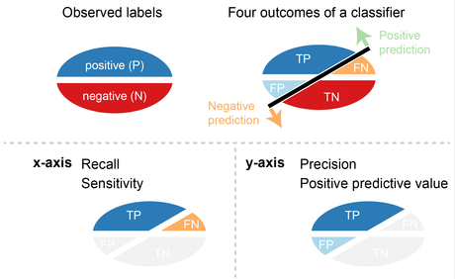
Precision-Recall Plot
A dataset has two labels (P and N), and a classifier separates the dataset into four outcomes – TP, TN, FP, FN.
The precision-recall plot is based on two basic measures – recall and precision that are calculated from the four outcomes.
Notes:
https://classeval.wordpress.com/introduction/introduction-to-the-precision-recall-plot/

Slide 35
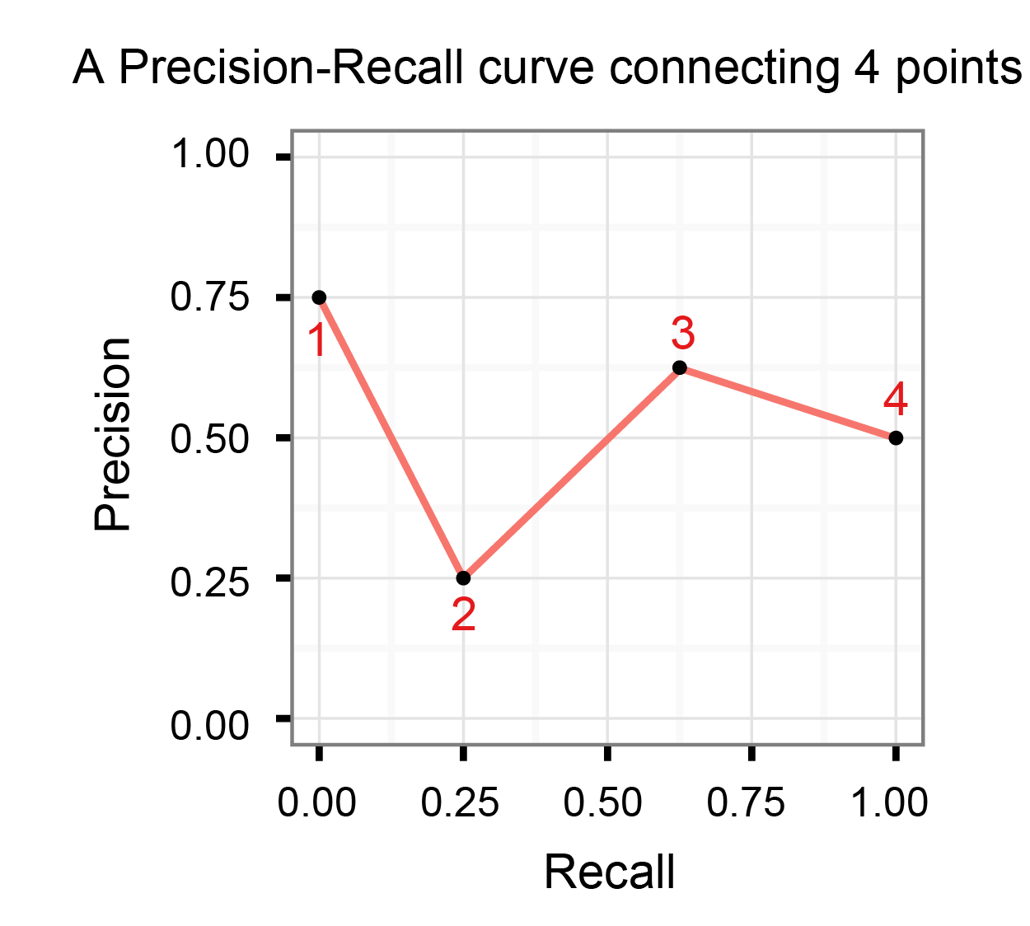
Precision-Recall Plot
The precision-recall plot uses recall on the x-axis and precision on the y-axis.
A precision-recall curve is created by connecting all precision-recall points of a classifier.
Two adjacent precision-recall points can be connected by a straight line.

Slide 36
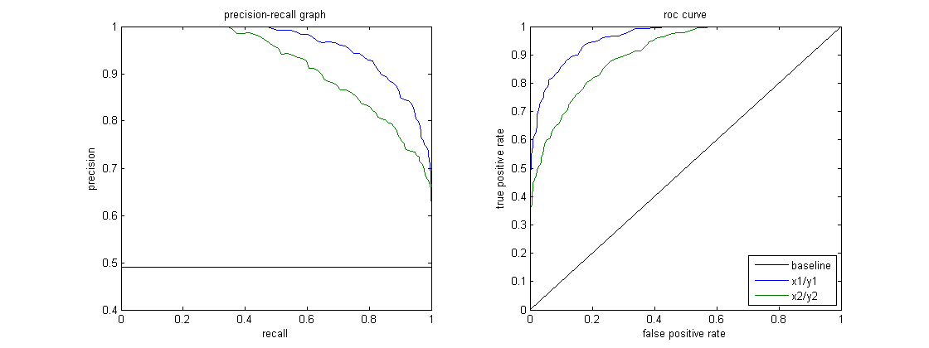
Precision-Recall Plot Example
Notes:
https://classeval.wordpress.com/introduction/introduction-to-the-precision-recall-plot/

Slide 37
Model Evaluation
Metrics for Performance Evaluation
How to evaluate the performance of a model?
Methods for Performance Evaluation
How to obtain reliable estimates?
Methods for Model Comparison
How to compare the relative performance among competing models?

Slide 38
Methods for Performance Evaluation
How to obtain a reliable estimate of performance?
Problem: Performance of a model may depend on other factors besides the learning algorithm
Class distribution
Cost of misclassification
Size of training and test sets

Slide 39
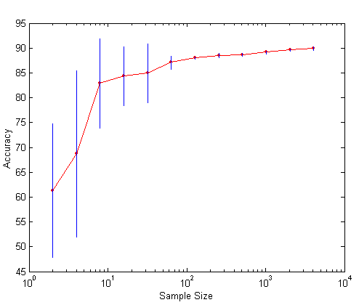
Learning Curve
Learning curve shows how accuracy changes with varying sample size
Requires a sampling schedule for creating learning curve
Effect of small sample size:
Bias in the estimate
Variance of estimate

Slide 40
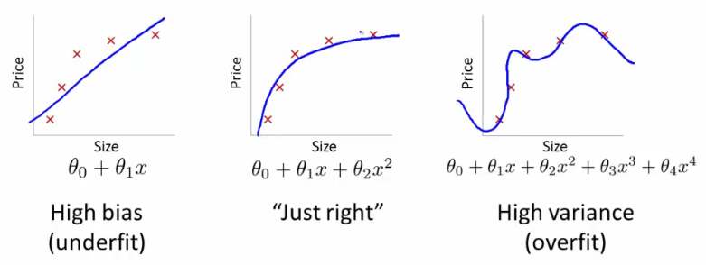
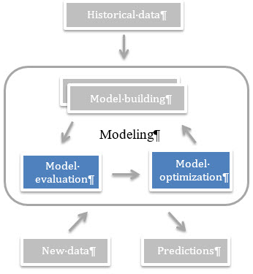
Model Evaluation: Which is better?
Notes:
https://freecontent.manning.com/real-world-machine-learning-model-evaluation-optimization/

Slide 41
Methods of Reliable Estimation of Performance: Cross Validation
Holdout
Reserve 2/3 for training and 1/3 for testing
Random subsampling
One sample may be biased, hence, repeated holdout
k-fold Cross validation
Partition data into k disjoint subsets
k-fold: train on k-1 partitions, test on the remaining one
Leave-one-out: k=n
Guarantees that each record is used the same number of times for training and testing
Bootstrap
Sampling with replacement
Notes:
https://www.cs.cmu.edu/~schneide/tut5/node42.html

Slide 42
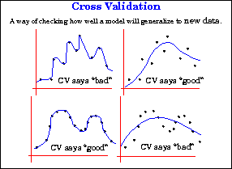
Cross Validation

Slide 43
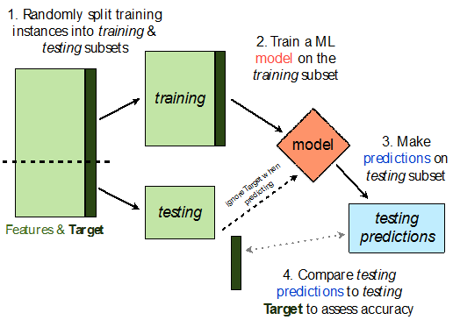
Holdout
The data set is separated into two sets: training set (2/3) and the testing set (1/3).
The function approximator (model learner) fits a function using the training set only. Then the function approximator is asked to predict the output values for the data in the testing set (it has never seen these output values before).
Disadvantage: its evaluation can have a high variance. The evaluation may depend heavily on which data points end up in the training set and which end up in the test set, and thus the evaluation may be significantly different depending on how the division is made.
Used when we have many instances for each class.

Slide 44
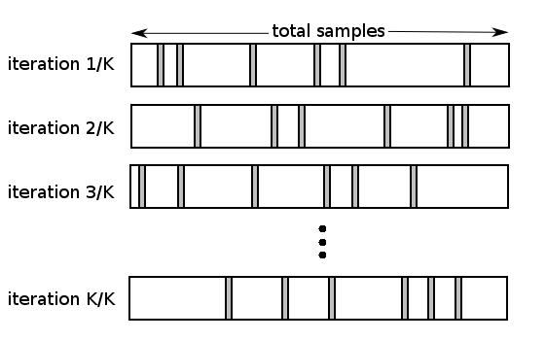
Random Subsampling
Monte Carlo cross validation
Randomly splitting the data into a training and a test set as multiple holdout
The random partitioning of the data can be repeated arbitrarily often.
The data is trained on the training set and the mean square error (MSE) is obtained from the predictions on the test set.
Disadvantage: The MSE would depend on the split. So a new split can give you a new MSE and then you don’t know which to trust.
Notes:
http://www.frank-dieterle.com/phd/2_4_3.html

Slide 45
k-fold Cross Validation
The data set is divided into k subsets, and the holdout method is repeated k times.
Each time, one of the k subsets is used as the test set and the other k-1 subsets are put together to form a training set.
Then the average error across all k trials is computed.
Advantage: it matters less how the data gets divided. Every data point gets to be in a test set exactly once, and gets to be in a training set k-1 times. The variance of the resulting estimate is reduced as k is increased.
Disadvantage: the training algorithm has to be rerun from scratch k times, which means it takes k times as much computation to make an evaluation (computationally intensive)
Notes:
https://machinelearningmastery.com/k-fold-cross-validation/

Slide 46
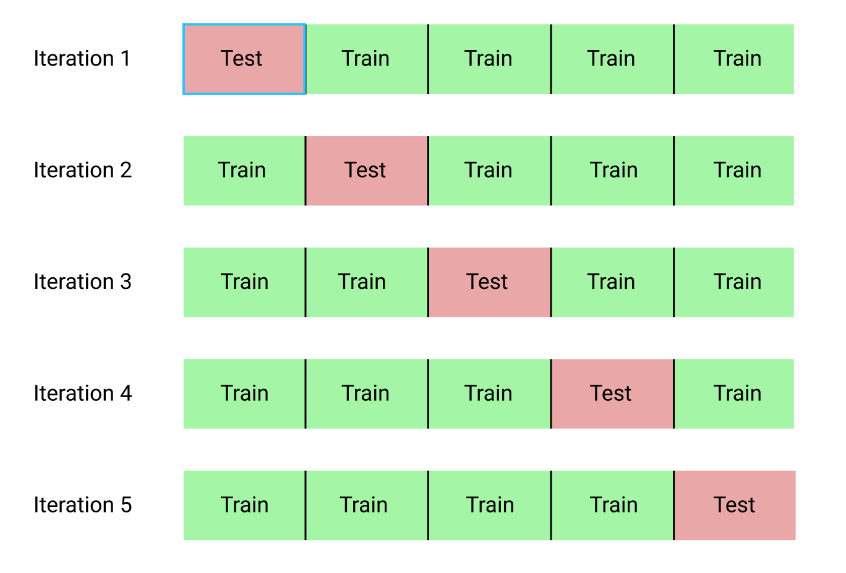
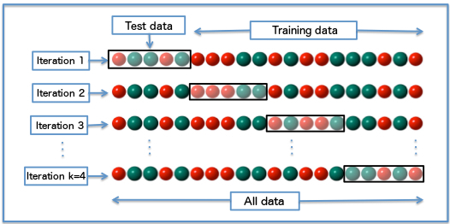
k-fold Cross Validation

Slide 47
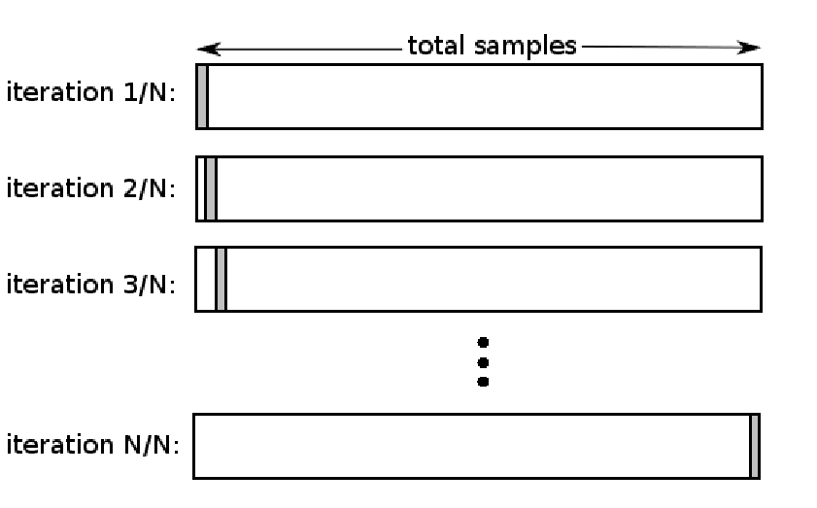
Leave-one-out Cross Validation
K-fold cross validation taken to its logical extreme, with K equal to N, the number of data points in the set.
That means that N separate times, the function approximator is trained on all the data except for one point and a prediction is made for that point.
Advantage: the average error is computed and used to evaluate the model (much reduced).
Disadvantage: very expensive to compute.

Slide 48
Model Evaluation
Metrics for Performance Evaluation
How to evaluate the performance of a model?
Methods for Performance Evaluation
How to obtain reliable estimates?
Methods for Model Comparison
How to compare the relative performance among competing models?

Slide 49
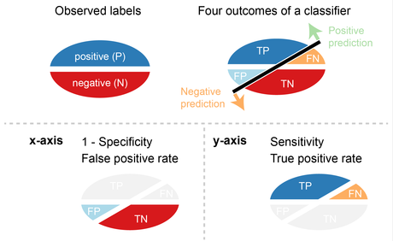
Receiver Operating Characteristics (ROC)
Performance of a classifier represented as a point on the ROC curve
ROC shows trade-offs between sensitivity (performance measure of the whole positive part of a dataset) and 1 - specificity (performance measure of the whole negative part of a dataset)
Changing some parameter of the algorithm, sample distribution or cost matrix changes the location of the point

Slide 50
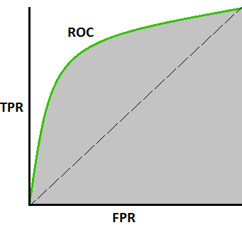
ROC Curve
ROC curve plots TPR (on the y-axis) against FPR (on the x-axis)
Trade-offs between true positive (benefits) and false positive (costs).
Fraction of positive instances predicted correctly
Fraction of negative instances predicted incorrectly
Notes:
https://en.wikipedia.org/wiki/Receiver_operating_characteristic

Slide 51
ROC (Receiver Operating Characteristic)
Trade-off between positive hits (Sensitivity or Recall or True Positive Rate or probability of detection) and false alarms (1 - Specificity or False Positive Rate or fall-out)
 | PREDICTED CLASS
Actual |  | Yes | No
 | Yes | a (TP) | b (FN)
 | No | c (FP) | d (TN)

Slide 52
Applications of ROC
The ROC curve was first developed by electrical engineers and radar engineers during World War II for detecting enemy objects in battlefields and was soon introduced to psychology to account for perceptual detection of stimuli.
ROC analysis since then has been used in medicine, radiology, biometrics, forecasting of natural hazards, meteorology, model performance assessment, and other areas for many decades and is increasingly used in machine learning and data mining research.

Slide 53
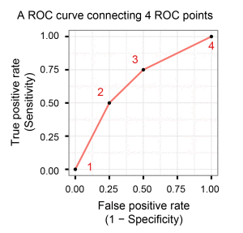
ROC Curve
A ROC point is a point with a pair of x and y values in the ROC space where x is 1 – specificity and y is sensitivity.
A ROC curve is created by connecting all ROC points of a classifier in the ROC space.
Two adjacent ROC points can be connected by a straight line, and the curve starts at (0.0, 0.0) and ends at (1.0, 1.0).
Notes:
https://classeval.wordpress.com/introduction/introduction-to-the-roc-receiver-operating-characteristics-plot/

Slide 54
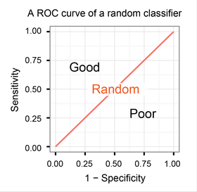
Interpretation of ROC curves: Random Classifier
Advantage: Easy interpretation
The curve separates the space into two areas for good and poor performance levels.
Baseline: A classifier with the random performance level always shows a straight line from the origin (0.0, 0.0) to the top right corner (1.0, 1.0).

Slide 55
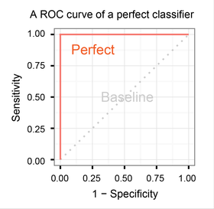
Interpretation of ROC curves: Perfect Classifier
A classifier with the perfect performance level shows a combination of two straight lines – from the origin (0.0, 0.0) to the top left corner (0.0, 1.0) and further to the top right corner (1.0, 1.0).

Slide 56
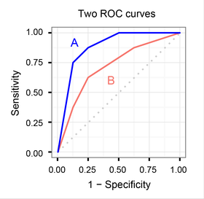
ROC curves for multiple models
Curves close to the perfect ROC curve have a better performance level than the ones closes to the baseline.
Two ROC curves represent the performance levels of two classifiers A and B.
Classifier A clearly outperforms classifier B in this example.

Slide 57
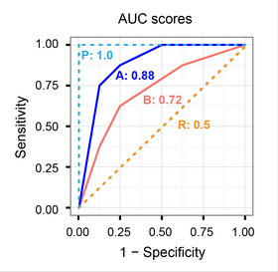
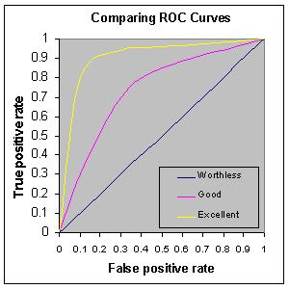
AUC (Area under the ROC curve) score
Although the theoretical range of AUC score is between 0.5 to 1
ROC curves clearly shows classifier A outperforms classifier B, which is also supported by their AUC scores (0.88 > 0.72).
Notes:
http://gim.unmc.edu/dxtests/roc3.htm

Slide 58
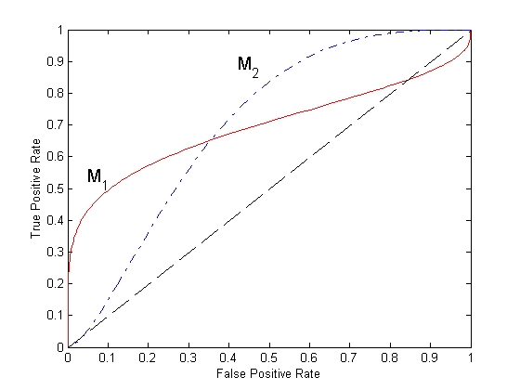
Using ROC for Model Comparison
No model consistently outperform the other
M₁ is better for small FPR
M₂ is better for large FPR
Area Under the ROC curve (AUC)
Between 0.5 - 1
Ideal: Area = 1
Random guess:
Area = 0.5

Slide 59
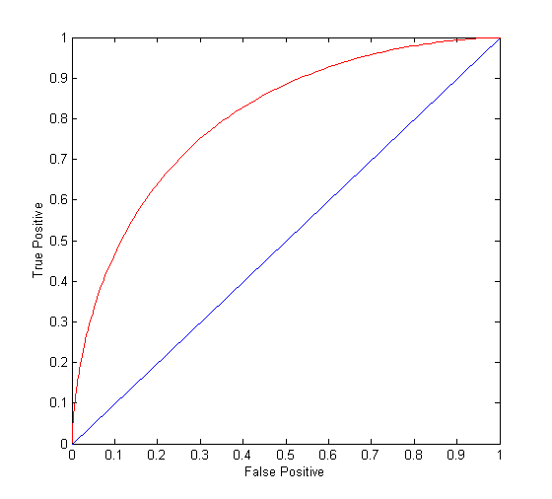
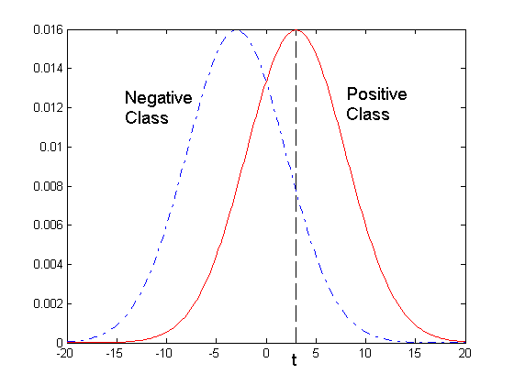
ROC Curve and ROC Points
- 1-dimensional data set containing 2 classes (positive and negative)
- any points located at x > t is classified as positive
At threshold t: TP=0.5, FN=0.5, FP=0.12, FN=0.88

Slide 60
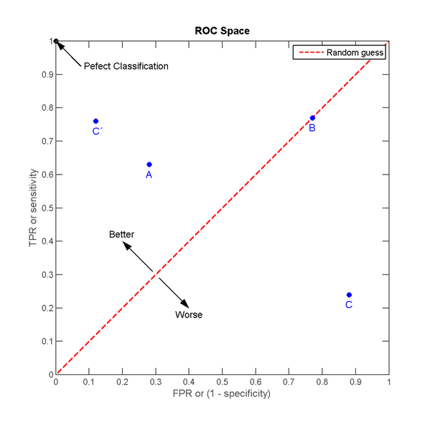
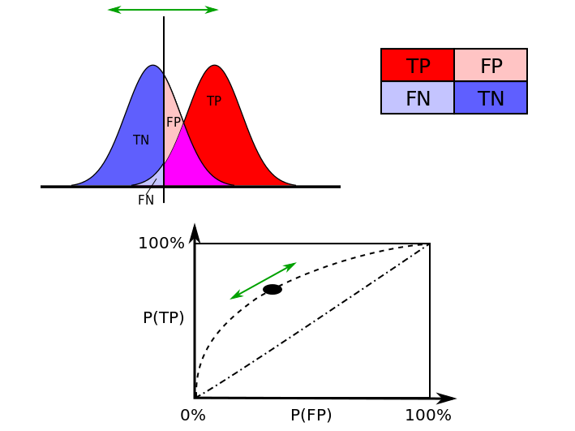
ROC Curve and ROC Points

Slide 61
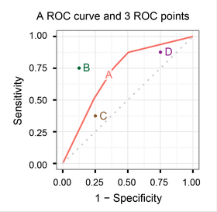
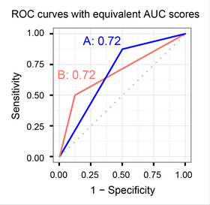
ROC Curve Summary
Sensitivity vs (1 − Specificity) plot
Each prediction result or instance of a confusion matrix represents one point in the ROC space.
The comparison between ROC curves and ROC points of different classifiers is valid only when the classifiers are evaluated on either a single dataset or multiple datasets that are almost identical among each other in terms of their data size and positive:negative ratio.
Even when two ROC curves have the same AUC values, the actual curves can be quite different.

Slide 62
ROC Curve vs. Precision-Recall Curve
ROC curve plot True Positive Rate Vs. False Positive Rate;
Precision-Recall curve plot Precision Vs. Recall.

Slide 63
ROC Curve vs. Precision-Recall Curve
ROC Curves summarize the trade-off between the true positive rate (TPR or recall) and false positive rate (FPR) for a predictive model using different probability thresholds.
Precision-Recall curves summarize the trade-off between the true positive rate (TPR or recall) and the positive predictive value (precision) for a predictive model using different probability thresholds.
ROC curves are appropriate when the observations are balanced between each class, whereas precision-recall curves are appropriate for imbalanced datasets.
Notes:
https://machinelearningmastery.com/roc-curves-and-precision-recall-curves-for-classification-in-python/
https://www.biostat.wisc.edu/~page/rocpr.pdf

Slide 64
Conclusion: Classifier Performance Evaluation
Metrics for Performance Evaluation: How to evaluate the performance of a model?
Confusion Matrix
Methods for Performance Evaluation: How to obtain reliable estimates (by samopling)?
Holdout Method
Random Subsampling
K-fold Cross Validation
Leave-one-out Cross Validation
Methods for Model Comparison: How to compare the relative performance among competing models?
Receiver Operating Characteristic (ROC) Curve
Precision-Recall Curve

Slide 65
Conclusion

Slide 66
Main References
Harrington, P (2012). Machine Learning in Action. Manning Publications.
Richert, W. and Coelho, L.P. (2013). Building Machine Learning Systems with Python. Packt Publishing.
Witten, I.H, Franck, E, and Hall, M. A. (2011). Data Mining: Practical Machine Learning Tools and Techniques. (3rd ed.). Morgan Kaufmann.
Pang-Ning Tan, Michael Steinbach, Anuj Karpatne, Vipin Kumar (2018). Introduction to Data Mining (2nd Edition), Pearson

Slide 67
Other References
J. Grus (2015). Data Science from Scratch: First Principles with Python. O'Reilly Media.
C. C. Aggarwal. (2015). Data Mining: The Textbook. Springer
Richert, W. and Coelho, L.P. (2013). Building Machine Learning Systems with Python. Packt Publishing.
Russel M.A. (2013). Mining the Social Web: Data Mining Facebook, Twitter, LinkedIn, Google+, GitHub, and More. (2nd Ed). O’Reilly Media.

